Slide 1
Working from the Home Environment & Well-Being Study Data
Team 1
Vani Singhal (TL)
Ming-Han Hsieh
Wei-Tse Kao
Jessica Woo

Slide 2
Garmin Data Analysis

Slide 3
Cleaning the Garmin Data
Extracted one value for each data type per day
For calories, steps, floorsClimbed, and intensityMinutes: we took the max value for each day
For heart rate: we had to replace the 0 values before taking the average, so we replaced them with a random value between 60-100, which is the normal heart rate for adults (source: American Heart Association).
For stress: we found the average for each day
We did not include pulseOx and ibi in this process
We also filtered out the participants that did not have the correct amount of data in each folder
62 files in the 3 month folder - found 62 participants
63 files in the 6 month folder - found 58 participants
The cleaned data can be found here.
Notes:
We had to process each data type differently. For example, for calories, steps, floorsCliimbed, and intensityMinutes, the values represented the cumulative value at the current time the Garmin watch recorded the data, which is why we took the maximum value for each day rather than taking the average value (because taking the average of cumulative values didn’t make sense to us). // We didn’t include pulse ox because it’s a measure of the blood oxygen levels and we didn’t think this information was meaningful. We also didn’t include ibi (interbeat interval) because (include reason).

Slide 4
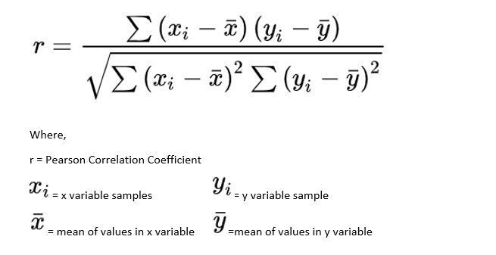
Finding Relationships
To visualize the comparison, we plotted the 6 month Garmin data and survey data onto a dual axis line graph.
We calculated the Pearson correlation coefficient between the Garmin data and the chosen survey data type, then did a p-test to determine whether or not the correlation was statistically significant.

Slide 5
Relationship between Flourishing Scale and Garmin Data

Slide 6
Flourishing Scale - Domain
The Flourishing Scale Survey has 6 domains and for each domain there has 2 questions, and for each question there is score from 1-10
Happiness and Life Satisfaction.
Mental and Physical Health
Meaning and Purpose
Character and Virtue
Close Social Relationships
Financial and Material Stability

Slide 7
Preprocessing Flourishing Scale Survey Data
The flourishing scale data was in Friday AM data.
I calculated the score for each domains. Then I calculated the “Secure Flourish” which is obtained by summing the scores from all six domains.
Merged the cleaned garmin data and this survey data. We filtered out the 6 month data from May to October.
Then I grouped the merged data by month and calculated the mean for each Garmin data type and domains

Slide 8
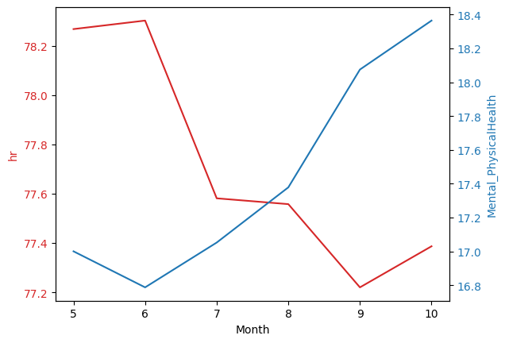
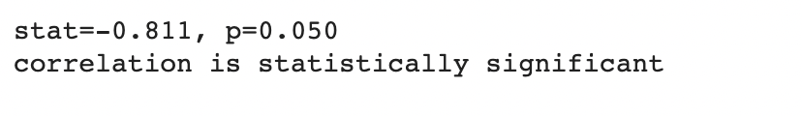
Flourishing Scale-Mental and Physical Health vs Heart Rate
Number of participants - 43
Correlation
The graph shows there is a negative correlation
Pearson Correlation Test
Significance value alpha = 0.05
P-value = 0.050
Correlation coefficient = -0.811

Slide 9
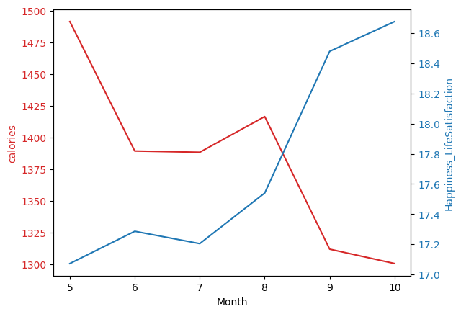
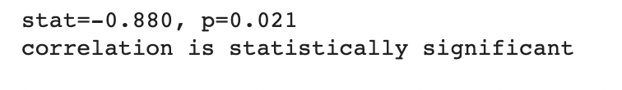
Flourishing Scale-Happiness and Life Satisfaction vs Calories
Number of participants - 43
Correlation
The graph shows there is a negative correlation
Pearson Correlation Test
Significance value alpha = 0.05
P-value = 0.021
Correlation coefficient = -0.880

Slide 10
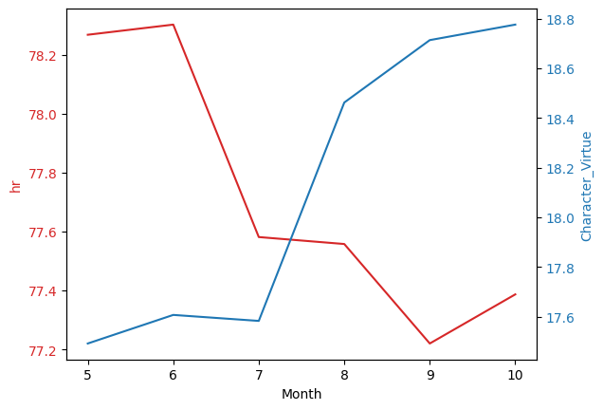
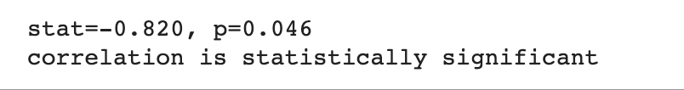
Flourishing Scale-Character and Virtue vs Heart Rate
Number of participants - 43
Correlation
The graph shows there is a negative correlation
Pearson Correlation Test
Significance value alpha = 0.05
P-value = 0.046
Correlation coefficient = -0.820

Slide 11
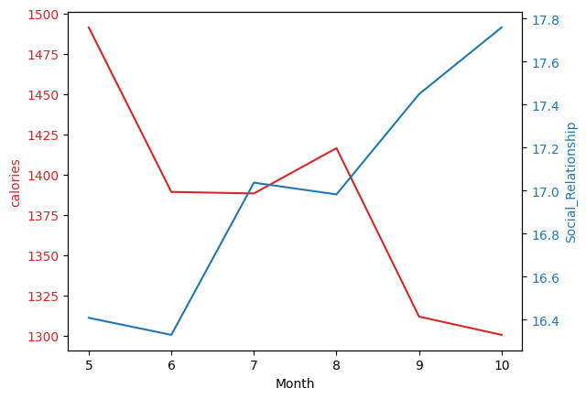
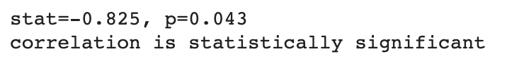
Flourishing Scale- Close Social Relationship vs Calories
Number of participants - 43
Correlation
The graph shows there is a negative correlation
Pearson Correlation Test
Significance value alpha = 0.05
P-value = 0.043
Correlation coefficient = -0.825

Slide 12
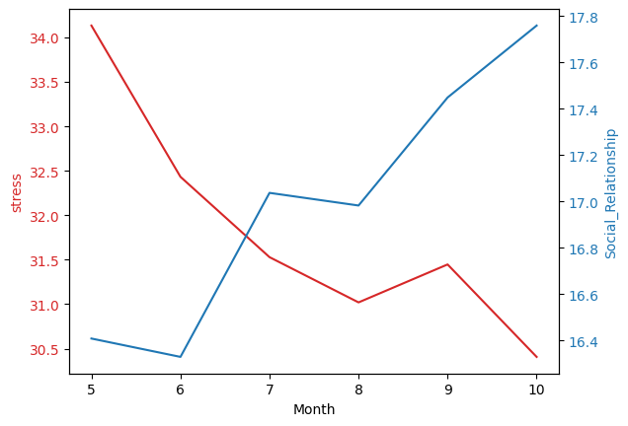

Flourishing Scale-Close Social Relationship vs Stress
Number of participants - 43
Correlation
The graph shows there is a negative correlation
Pearson Correlation Test
Significance value alpha = 0.05
P-value = 0.046
Correlation coefficient = -0.819

Slide 13
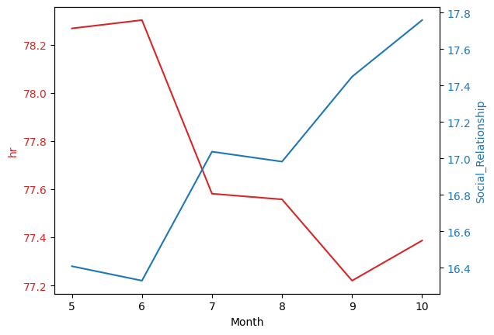

Flourishing Scale-Close Social Relationship vs Heart Rate
Number of participants - 43
Correlation
The graph shows there is a negative correlation
Pearson Correlation Test
Significance value alpha = 0.05
P-value = 0.007
Correlation coefficient = -0.929

Slide 14
Relationship between Joint Pain Homunculus and Garmin Data

Slide 15
Preprocessing Joint Pain Homunculus Data
The Joint Pain Homunculus asked participants to indicate their pain on 68 different parts of the body based on the Visual Analog Scale.
This survey data was separated into Daily PM and Friday PM, so I merged both files
For each participant, I took the sum of all the individual scores given for each body part to get a total score (labeled as “sum”)
Merged the cleaned 6 month Garmin data with the calculated total
Grouped the merged data by month and calculated the mean for each Garmin data type and homunculus score

Slide 16
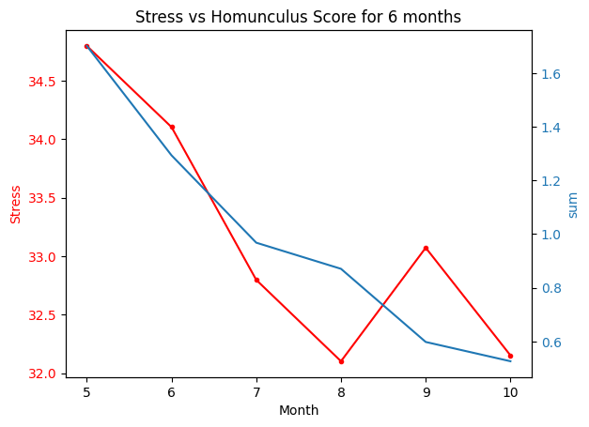

Joint Pain Homunculus Data vs Stress
n = 41
Correlation
The graph shows there is a positive correlation.
Pearson Correlation Test
Significance value alpha = 0.05
P-value = 0.024
Correlation coefficient = 0.871

Slide 17
Relationship between E-Work Life Scale and Garmin Data

Slide 18
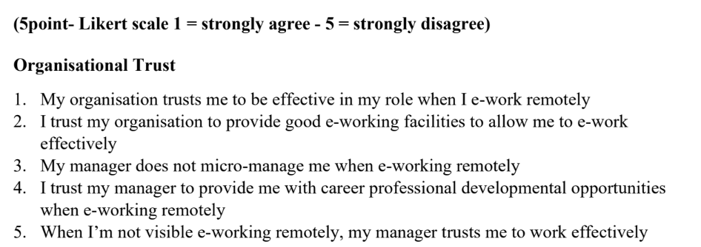
E-Work Life Scale - Domain
The E-Worklife Scale Survey has 4 domains and for each domain there has 4~6 questions, and for each question you can rate from 1(strongly agree) to 5(strongly disagree).
Organisational Trust
Flexibility
Work life Interference
Effectiveness/Productive

Slide 19
Preprocessing E-Work Life Scale Data
The E-work Life scale data was in Friday_PM survey data.
Merged the cleaned garmin data and this survey data. We filtered out the 6 month data from May to October.
Grouped the merged data by month and calculated the mean for each Garmin data type and domains.
Calculated the total score for each domains.
Calculated the “E_Worklife_Scale” which is the summation scores of each domain from all four domains.

Slide 20
E-Work Life Scale - Correlation Test
We tried to find the correlation between the domains in E-Work Life scale and the attributes below in the Garmin data.
Calories
Steps
Stress
Hr(Heart rate)

Slide 21
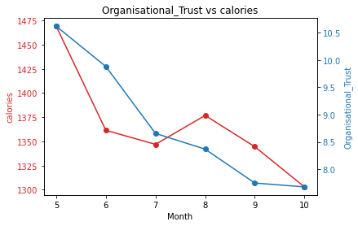

E-Work Life Scale: Organisational_Trust vs calories
Number of participants - 42
Correlation
The graph shows there is a positive correlation
Pearson Correlation Test
Significance value alpha = 0.05
P-value = 0.042
Correlation coefficient = 0.827

Slide 22
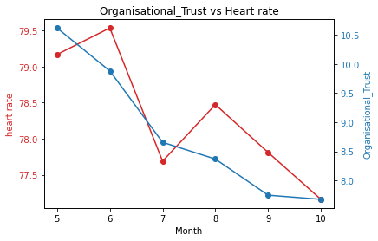

E-Work Life Scale: Organisational_Trust vs heart rate
Number of participants - 42
Correlation
The graph shows there is a positive correlation
Pearson Correlation Test
Significance value alpha = 0.05
P-value = 0.026
Correlation coefficient = 0.866

Slide 23
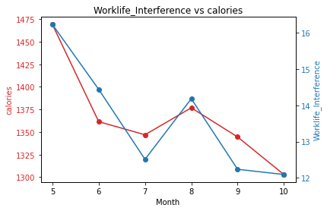

E-Work Life Scale: Worklife_Interference vs Calories
Number of participants - 42
Correlation
The graph shows there is a positive correlation
Pearson Correlation Test
Significance value alpha = 0.05
P-value = 0.009
Correlation coefficient = 0.921

Slide 24
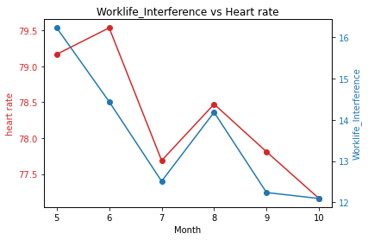

E-Work Life Scale: Worklife_Interference vs Heart rate
Number of participants - 42
Correlation
The graph shows there is a positive correlation
Pearson Correlation Test
Significance value alpha = 0.05
P-value = 0.026
Correlation coefficient = 0.864

Slide 25
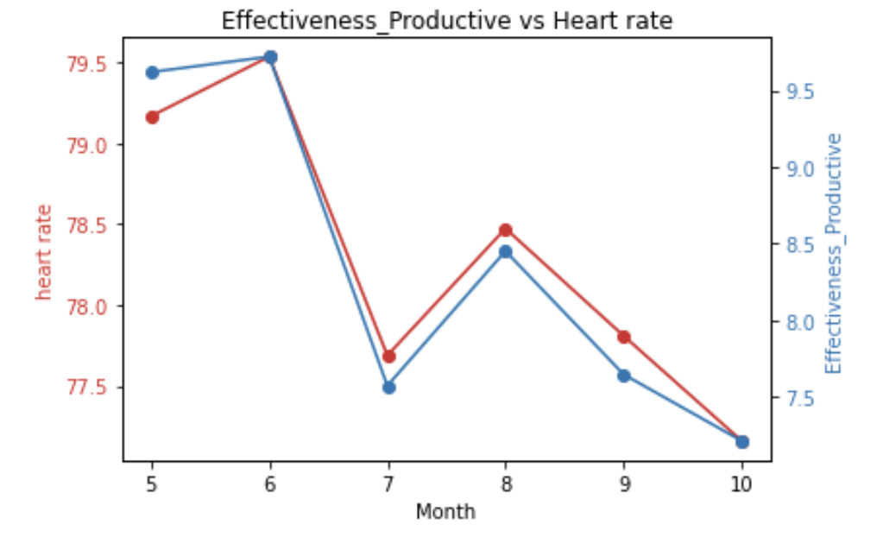

E-Work Life Scale: Effectiveness_Productive vs Heart rate
Number of participants - 42
Correlation
The graph shows there is a positive correlation
Pearson Correlation Test
Significance value alpha = 0.05
P-value = 0.000
Correlation coefficient = 0.988

Slide 26
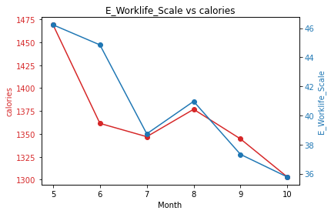

E-Work Life Scale: E_Worklife_Scale vs Calories
Number of participants - 42
Correlation
The graph shows there is a positive correlation
Pearson Correlation Test
Significance value alpha = 0.05
P-value = 0.038
Correlation coefficient = 0.836

Slide 27
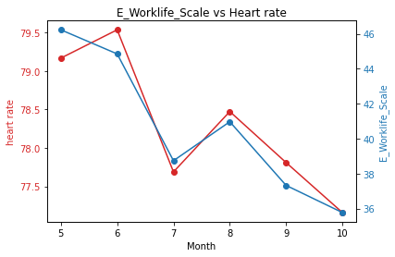

E-Work Life Scale: E_Worklife_Scale vs Heart rate
Number of participants - 42
Correlation
The graph shows there is a positive correlation
Pearson Correlation Test
Significance value alpha = 0.05
P-value = 0.002
Correlation coefficient = 0.960

Slide 28
E-Work Life Scale: Conclusion
Positive correlation:
Organisational Trust - calories, hr
Flexibility - None
Worklife_Interference - calories, hr
Effectiveness\Productive - hr
E-Work Life Scale - calories, hr

Slide 29
Relationship between Computer Workstation Checklist and Garmin Data

Slide 30
Computer Workstation Checklist Score vs Garmin Data
Calculated the total score for all questions and checked the relationship with the garmin data
Total Score vs Calories
Total Score vs Stress
Total Score vs Steps
Total Score vs Heart Rate
Total Score vs Intensity in Minutes
Total Score vs Floors Climbed
Results
There were no correlations that are significantly correlated

